Slide 1

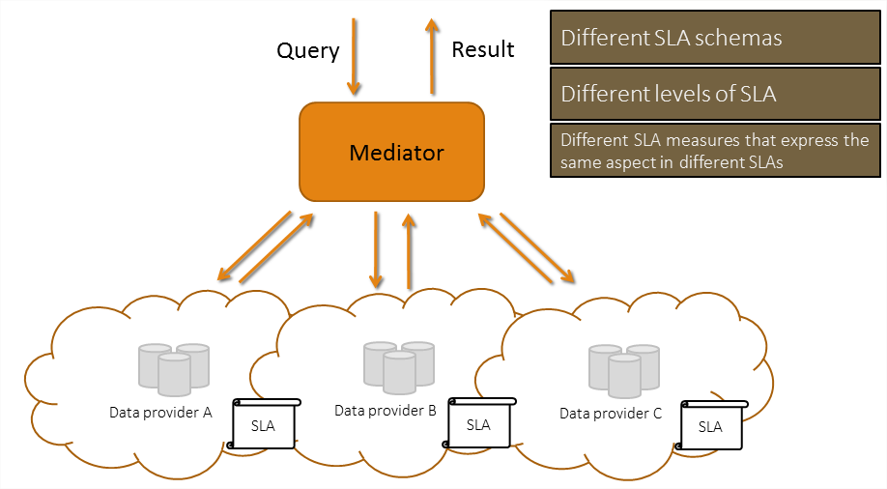





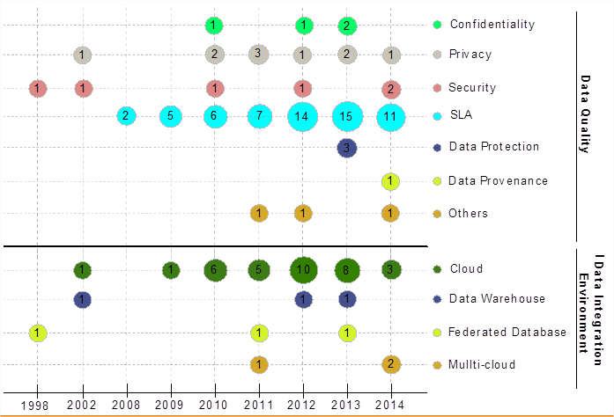
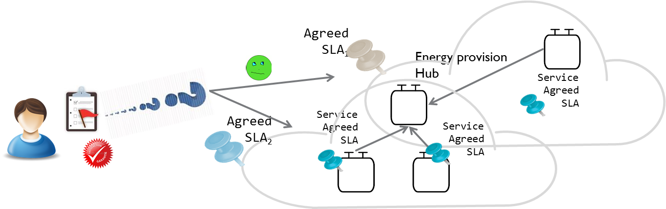
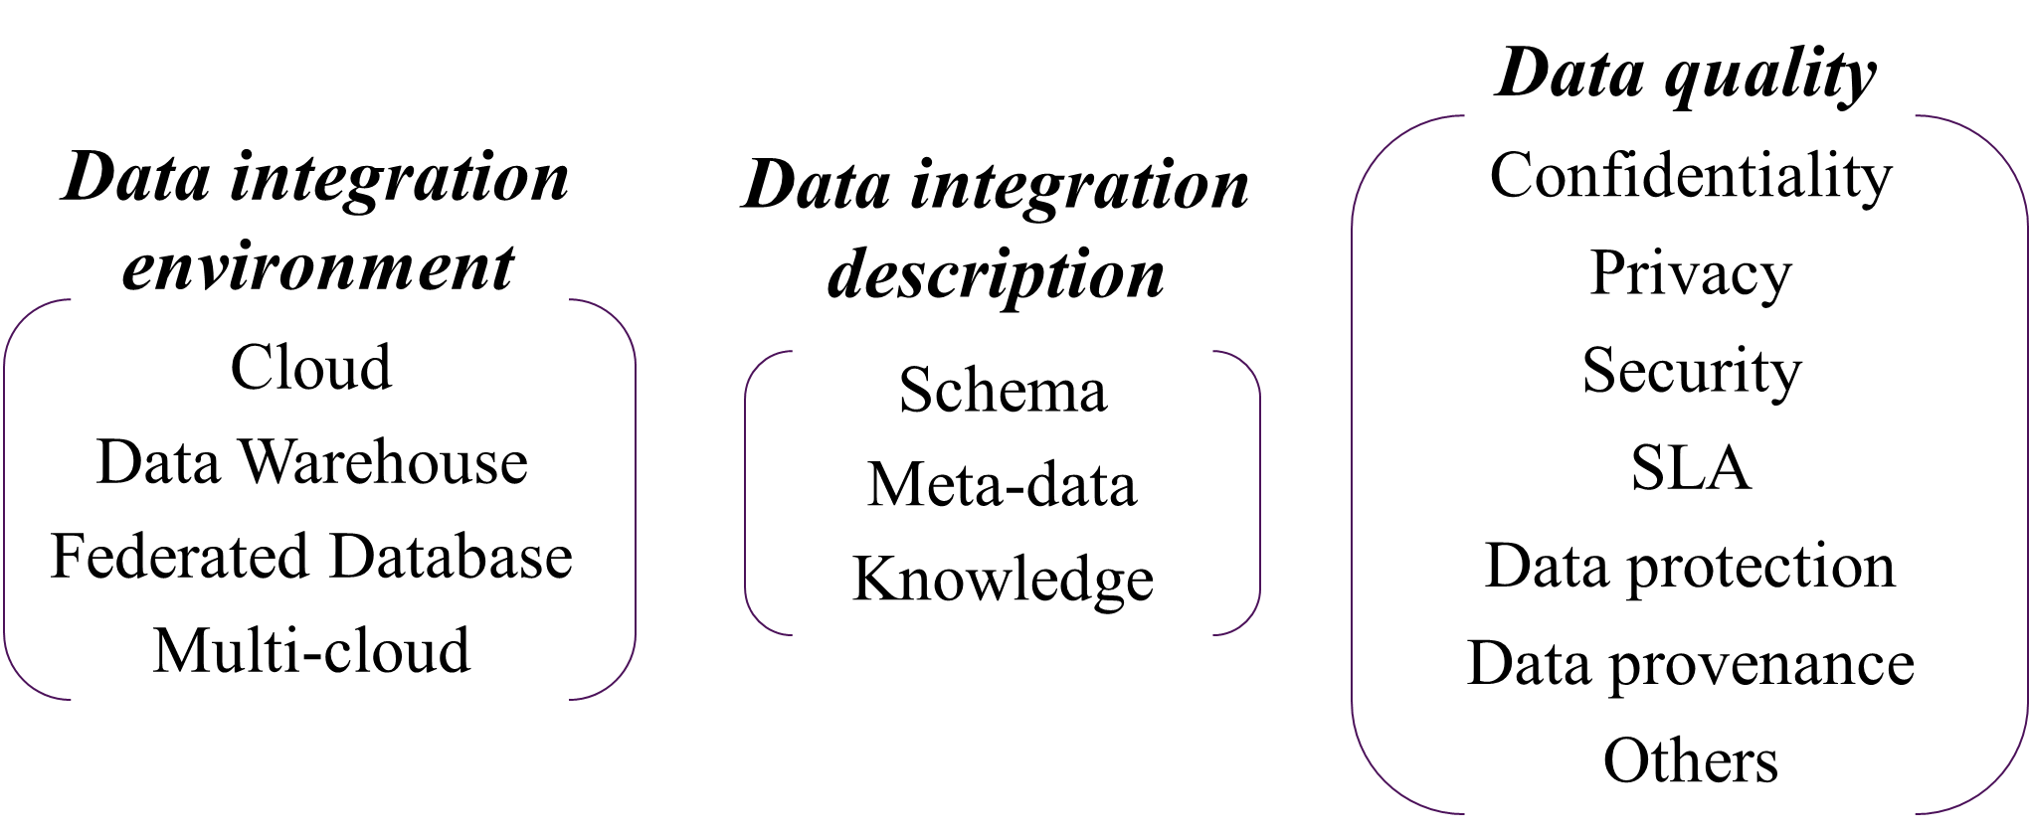



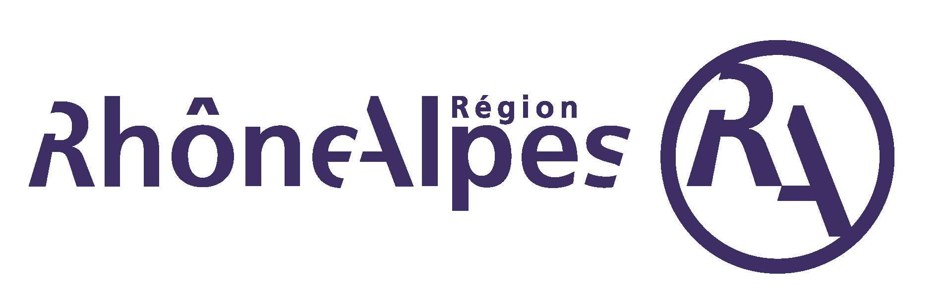
Mondes numériques pour l’humain et la société : conception, comportements et usages
ARC 6 : Technologies de l’Information et de la Communication
et Usages Informatiques Innovants
SLA-Guided Data Integration on Multi-cloud Environment
The emergence of cloud computing opens new challenges to data integration:
The possibility of an unlimited access to resources changes the problems associated to data processing
The definition of requirements and obligations between the provider and customer through service level agreement (SLA).
Approaches combining SLA and data integration have not been enough explored in the literature.
General Objective: Propose a data integration approach in a multi-cloud environment guided by user preferences and SLA
POINTS CLES
TRAVAUX ENGAGES / RESULTATS
Model quality measures linked to data and to cloud resources
Use Service Level Agreement (SLA) for guiding the data integration process performed on a multi-cloud
Match data providers (services) to queries for integrating data according to the user requirements and the SLAs.
Problem statement and state of the art by applying a
systematic mapping process
Data integration classification scheme
Service based query rewriting approach guided by SLA
Rhône algorithm service based query rewriting considering user preferences and quality aspects expressed as SLA contracts
On going work:
Query rewriting taxonomy of existing algorithms from the service composition and database domains
formalization and Implementation of the Rhone algorithm: biological use case scenario
Experimentation platform on the cloud using Open Stack to test and evaluate the service-based query rewriting algorithm
Defining research
questions
Conduct search on
scientific databases
Selecting papers
Keywording using
abstracts
Data extraction and
Mapping process
Defining the scope
Retrieving papers
(conjunctive/disjunctive query)
Relevant papers
(analyzing titles and abstracts)
Producing a
classification scheme
Generating mapping
results
PROBLEMATIQUE
Focused Research Questions:
RQ1: Which are the SLA measures that have been mostly applied in the cloud?
RQ2: How have published papers on data integration evolved towards cloud topics?
RQ3: In which way and in which context data integration have been used to Quality of Service (QoS) measures in the literature?
Results*
Efficiently obtain results for queries addressing services deployed in a multi-cloud environment by:
  Fulfilling user QoS requirements
  Respecting subscribed contracts with the involved cloud provider(s),
  Respecting services contracts (constraints).
Challenges:
How to be sure that all the agreed SLAs are respected while satisfying the user?
Can my constraints be satisfied? Which services shall I ask for?
How can resources be saved for next query?
How to perform the query rewriting matching services that answer the query and satisfy the quality preferences?
How to integrate different SLA associated to services involved with user’s quality preferences?
Database | Amount | Included | Excluded
IEEE | 658 | 56 | 602
ACM | 649 | 31 | 618
Science Direct | 106 | 6 | 100
CiteSeerX | 419 | 21 | 398
Total | 1832 | 114 | 1718
* D. A. S. Carvalho, P. A. Souza Neto, G. Vargas-Solar, N. Bennani, C. Ghedira, Can Data Integration Quality be Enhanced on Multi-cloud using SLA?, In 26th Int. Conf. on Database and Expert Systems Applications, Spain, 2015.
Daniel Aguiar da Silva Carvalho, Magellan, IAE, Univ. J-Moulin Lyon 3 - France
Chirine Ghedira Guegan, Magellan, IAE, Univ. J-Moulin Lyon 3 - France
Nadia Benani, CNRS INSA-Lyon, LIRIS, UMR5205 - France
Genoveva Vargas-Solar, CNRS, LIG-LAFMIA, Saint Martin d'Hères - France

